Slide 1
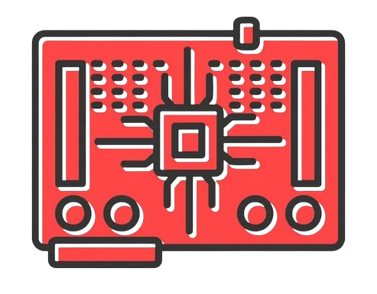
CSE 1125
Digital Logic Design
Slide From : Syed Eftasum Alam
E-mail : syed.efta@gmail.com
Some Contents here taken from Lecturer Raiyan Rahman’s slide and Prof.Salekul Islam’s slides

Slide 2
What is Digital Logic Design
Digital logic design in computer science (CS) refers to the process of designing and implementing digital circuits and systems using principles of logic and Boolean algebra.
These digital circuits are fundamental components of computer hardware and various electronic devices, allowing them to perform tasks such as computation, data processing, and control
2

Slide 3
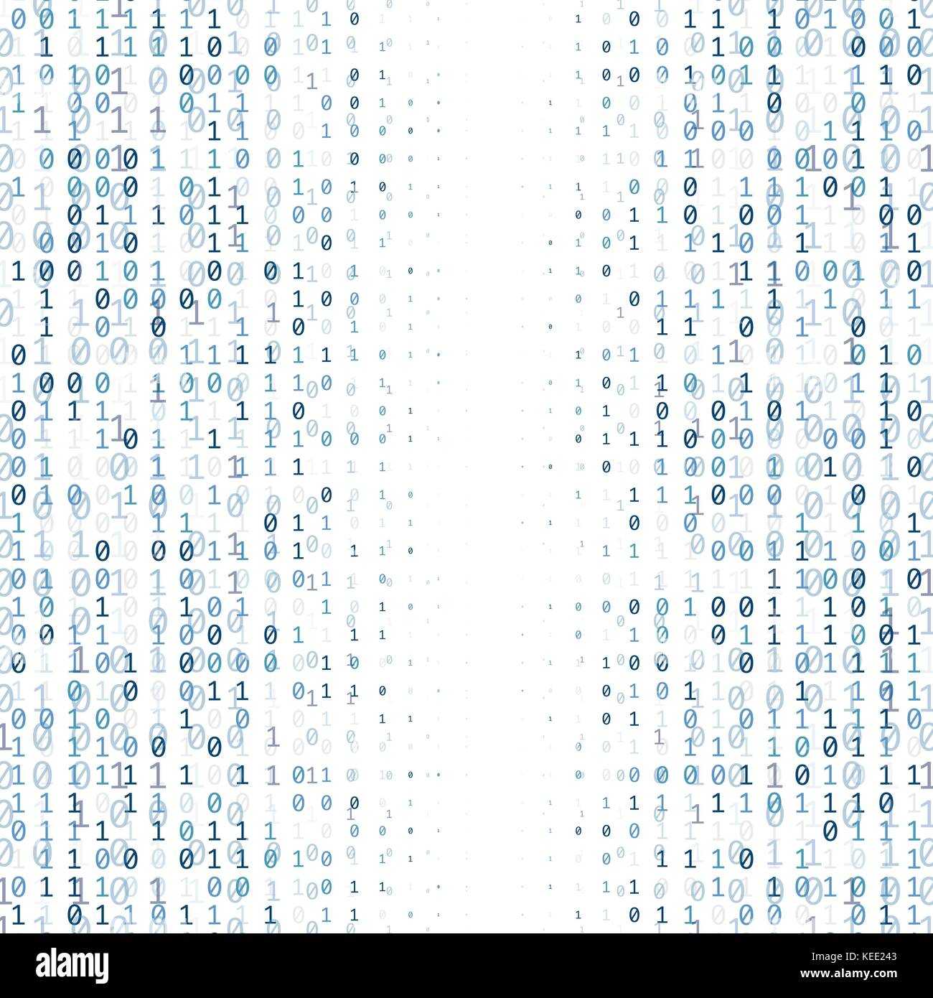
Why is it called Digital Logic Design
Digital logic design is called so because it primarily deals with the design and manipulation of digital signals, which represent information using discrete values, typically represented as binary digits (0 and 1).
3

Slide 4
Lecture Outline
A Brief History of Numbers and Civilizations
Understanding our Number system ?
• Binary to decimal
• Octal to decimal
• Hexadecimal to decimal
What our numbers can mean to other civilizations
• Decimal to binary
• Decimal to octal
• Decimal to hexadecimal
Conversion of number systems with 2n digits
• Octal ↔ Binary
• Hexadecimal ↔ Binary
• Octal ↔ Hexadecimal
Binary Codes
Binary Coded Decimal (BCD)
Binary arithmetic
• Single Bit Addition with Carry
• Multiple Bit Addition
• BCD Addition
4

Slide 5
Numbers !!!
4

Slide 6
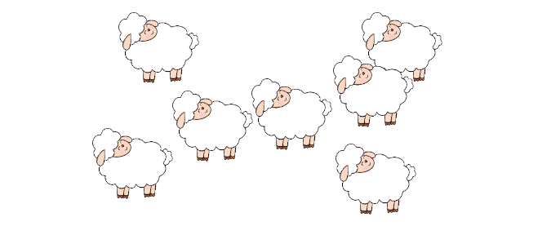
A Brief History of Numbers and Civilizations
Counting Sheep :
Scenario: You are a person from the pre-historic era, without any number system!
5

Slide 7
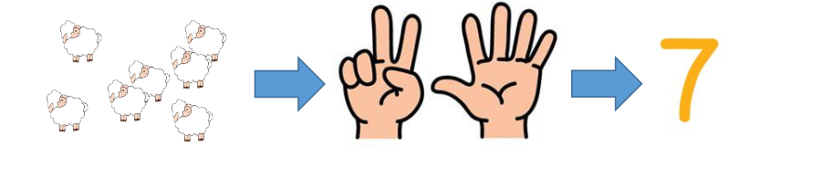
A Brief History of Numbers and Civilizations
Simple Approach :
6

Slide 8
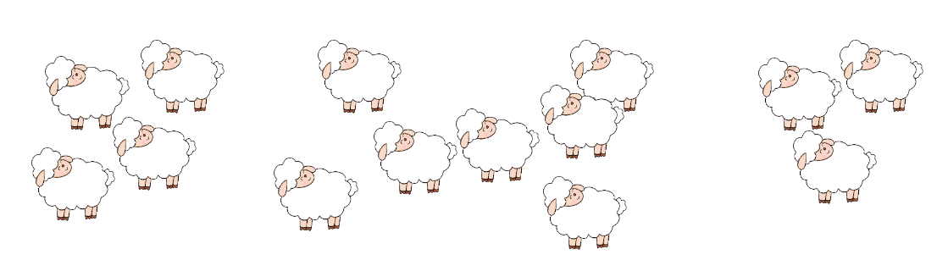
A Brief History of Numbers and Civilizations
Counting Sheep :
Now?
7

Slide 9
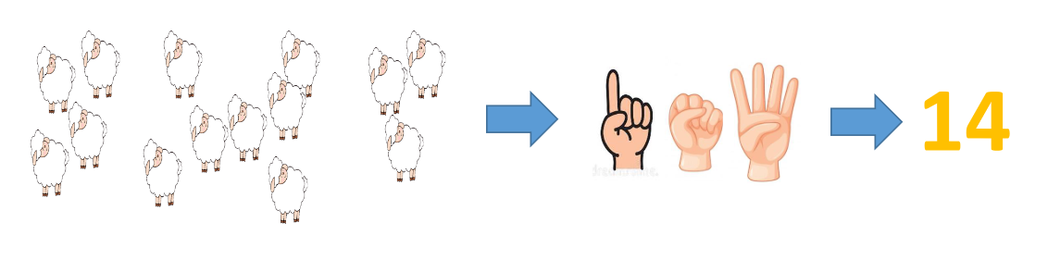
A Brief History of Numbers and Civilizations
Counting Sheep :
Develop Different approach according to your need.
8

Slide 10
A Brief History of Numbers and Civilizations
Different Civilizations Different Number Systems
• Arabs
• 10 digits – base 10 number system
• We just saw
• Mayans
• 20 digits – base 20 number system
• They did not wear sandals as they lived in a hot climate
• Babylonians
• 60 digits – base 60 number system
• The number 60 was important to them because they were engaged deeply in astronomical studies, also because we have 12 joint in our 4 fingers (excluding the thumb) and 60 is a multiple of 12.
• The Babylonians also came up with the concept of-
• a degree being divided into 60 minutes
• with each minute being divided into 60 seconds.
9

Slide 11
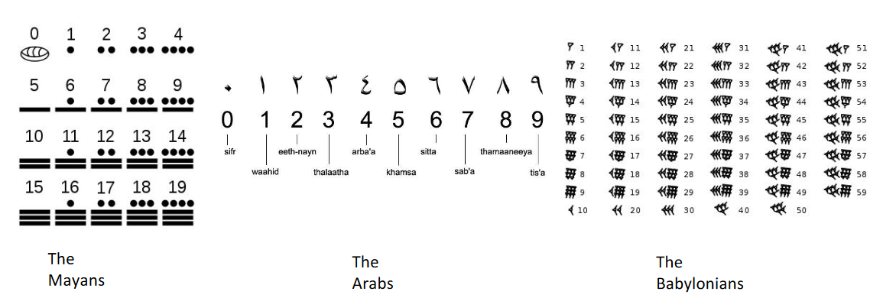
A Brief History of Numbers and Civilizations
10

Slide 12
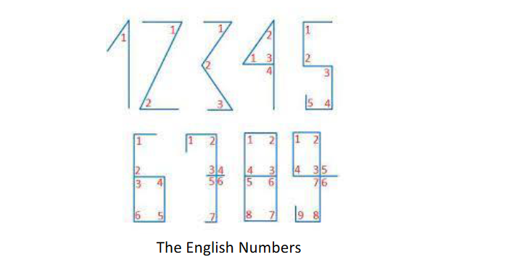
A Brief History of Numbers and Civilizations
11

Slide 13
Understanding our Number system (Decimal)
0 | 1 | 2 | 3 | 4 | 5 | 6 | 7 | 8 | 9
Total Unique Digits : 10
So, its Base / Radix is 10
BASE
(512)₁₀= 5 X 10² + 1 X 10¹ + 2X10⁰
(512.23)₁₀= 5 X 10² + 1 X 10¹ + 2X10⁰ + 2X10⁻¹ + 3X10⁻²
12

Slide 14
Understanding our Number system
Binary Number system : Base=2
Example : (1101.11)₂
0 | 1
Octal Number system : Base=8
Example :(231.33)₈
0 | 1 | 2 | 3 | 4 | 5 | 6 | 7
Hexadecimal Number system : Base=16
Example :(A23B.C3)₁₆
0 | 1 | 2 | 3 | 4 | 5 | 6 | 7 | 8 | 9 | A | B | C | D | E | F
10 | 11 | 12 | 13 | 14 | 15
13

Slide 15
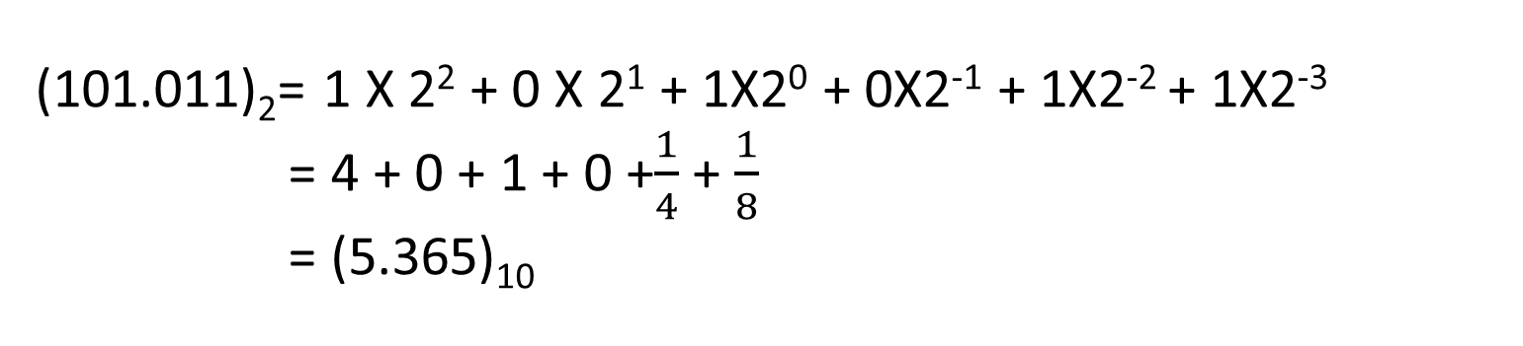
Binary → Decimal
(101.011)₂= 1 X 2² + 0 X 2¹ + 1X2⁰ + 0X2⁻¹ + 1X2⁻² + 1X2⁻³
= 4 + 0 + 1 + 0 +$\frac{1}{4}$ + $\frac{1}{8}$
= (5.365)₁₀
Try Solving yourself:
(00111.10100)₂
(1101.11100)₂
14

Slide 16
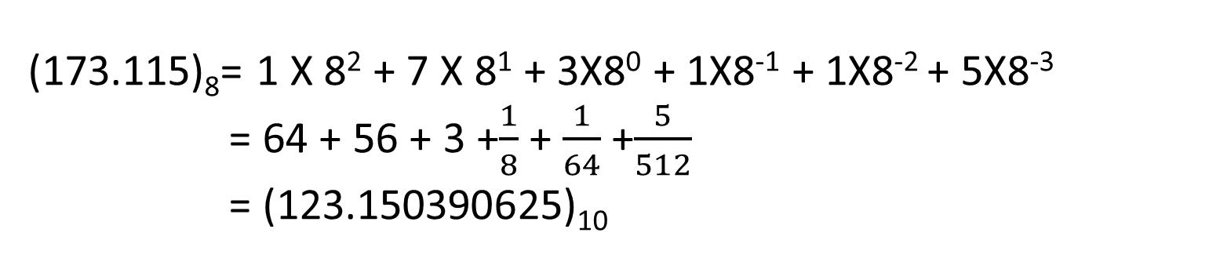
Octal → Decimal
(173.115)₈= 1 X 8² + 7 X 8¹ + 3X8⁰ + 1X8⁻¹ + 1X8⁻² + 5X8⁻³
= 64 + 56 + 3 +$\frac{1}{8}$ + $\frac{1}{64}$ +$\frac{5}{512}$
= (123.150390625)₁₀
Try Solving yourself:
(2331)₈
(33215.566)₈
15

Slide 17
Hexadecimal → Decimal
(A05.2B1)₁₆= A X 16² + 0 X 16¹ + 5X16⁰ + 2X16⁻¹ + BX16⁻² + 1X16⁻³
= 10 X 16² + 0 X 16¹ + 5X16⁰ + 2X16⁻¹ + 11X16⁻² + 1X16⁻³ = (2565.168212890625)₁₆
A | 10
B | 11
C | 12
D | 13
E | 14
F | 15
Try Solving yourself:
(CD421.A232)₁₆
(223B.12C)₁₆
16

Slide 18
Decimal → Binary
(233.54)₁₀ =(?)₂
2
233
2
116
1
233
.54
0.54 * 2 = 1.08 (Take the integer part, which is 1)
0.08 * 2 = 0.16 (Take the integer part, which is 0)
0.16 * 2 = 0.32 (Take the integer part, which is 0)
0.32 * 2 = 0.64 (Take the integer part, which is 0)
0.64 * 2 = 1.28 (Take the integer part, which is 1)
0.28 * 2 = 0.56 (Take the integer part, which is 0)
0.56 * 2 = 1.12 (Take the integer part, which is 1)
0.12 * 2 = 0.24 (Take the integer part, which is 0)
0.24 * 2 = 0.48 (Take the integer part, which is 0)
0.48 * 2 = 0.96 (Take the integer part, which is 0)
0.96 * 2 = 1.92 (Take the integer part, which is 1)
0.92 * 2 = 1.84 (Take the integer part, which is 1)
2
58
0
2
29
0
2
14
1
2
7
0
2
3
1
(233)₁₀ =(11101001) ₂
(0.54)₁₀ =(.100010100011) ₂
(233.54)₁₀ =(11101001.100010100011)₂
2
1
1
16

Slide 19
Decimal → Octal
(233.54)₁₀ =(?)₈
8
233
8
29
1
233
.54
8
3
5
0.54 * 8 = 4.32 (Take the integer part, which is 4)
0.32 * 8 = 2.56 (Take the integer part, which is 2)
0.56 * 8 = 4.48 (Take the integer part, which is 4)
0.48 * 8 = 3.84 (Take the integer part, which is 3)
0.84 * 8 = 6.72 (Take the integer part, which is 6)
0.72 * 8 = 5.76 (Take the integer part, which is 5)
(233)₁₀ =(351) ₈
(0.54)₁₀ =(.424365) ₈
(233.54)₁₀ =(351. 424365)₂
16

Slide 20
Decimal → Octal
(233.54)₁₀ =(?)₁₆
16
233
16
14
9
233
.54
0.54 * 16 = 8.64 (Take the integer part, which is 8)
0.64 * 16 = 10.24 (Take the integer part, which is 10)
E
A | 10
B | 11
C | 12
D | 13
E | 14
F | 15
(233)₁₀ =(E9) ₁₆
(0.54)₁₀ =(.8A) ₁₆
(233.54)₁₀ =(E9. 8A)₁₆
16

Slide 21
Decimal → Binary using 2^{n} Digits
Before proceeding let us see a shortcut method for converting decimals to binary.
Example − Convert decimal number 205 into binary number.
Decimal | 2⁷ = 128 | 2⁶ = 64 | 2⁵ = 32 | 2⁴ = 16 | 2³ = 8 | 2² = 4 | 2¹ = 2 | 2⁰ = 1
Binary | 1 | 1 | 0 | 0 | 1 | 1 | 0 | 1
205 = 128 + 64+ 8+ 4 +1
(205)₁₀ =(11001101)₂

Slide 22
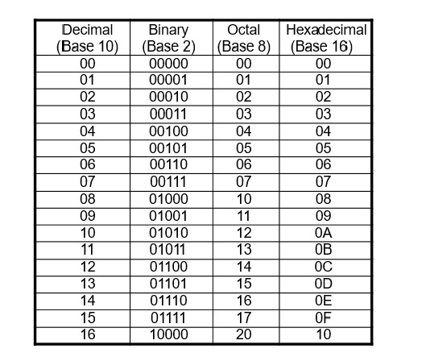
Numbers in Different Bases

Slide 23
Octal ↔ Binary
Octal to Binary:
Restate the octal as three binary digits starting at the radix point and going both ways.
Binary to Octal :
Group the binary digits into three-bit groups starting at the radix point and going both ways, padding with zeros as needed in the fractional part.
Convert each group of three bits to an octal digit.

Slide 24
Octal ↔ Binary
Octal to Binary:
Restate the octal as three binary digits starting at the radix point and going both ways.
(351)₈
(351)₈ =(?) ₂
011
001
101
(351)₈ =(011101001) ₂

Slide 25
Octal ↔ Binary
Octal to Binary:
Restate the octal as three binary digits starting at the radix point and going both ways.
(351.721)₈ =(?) ₂
(351.721)₈
011
101
001
111
010
001
(351.721)₈ =(011101001.111010001) ₂

Slide 26
Octal ↔ Binary
Binary to Octal:
Group the binary digits into three-bit groups starting at the radix point and going both ways, padding with zeros as needed in the fractional part.
Convert each group of three bits to an octal digit.
(1100100.11001)₂ =(?) ₈
(1100100.11001)₈
001
100
100
110
010
Padding with 0
1
4
4
6
2
(1100100.11001)₈ =(144.62) ₂

Slide 27
HexaDecimal ↔ Binary
Hexadecimal to Binary:
Restate the Hexadecimal as four binary digits starting at the radix point and going both ways.
Binary to Hexadecimal :
Group the binary digits into four-bit groups starting at the radix point and going both ways, padding with zeros as needed in the fractional part.
Convert each group of three bits to a Hexadecimal digit.

Slide 28
HexaDecimal ↔ Binary
Hexadecimal to Binary:
Restate the Hexadecimal as four binary digits starting at the radix point and going both ways.
(65.DC)₁₆ =(?) ₂
(65.DC)₁₆
0110
0101
1101
1100
(65.DC)₁₆ =(01100101.11011100) ₂

Slide 29
HexaDecimal ↔ Binary
Binary to Hexadecimal:
Group the binary digits into four-bit groups starting at the radix point and going both ways, padding with zeros as needed in the fractional part.
Convert each group of three bits to a Hexadecimal digit.
(001100101.110111)₂ =(?) ₁₆
(001100101.110111)₁₆
0000
0110
0101
1101
1100
Padding with 0
0
6
5
D
C
(001100101.110111)₂ =(065.DC) ₁₆

Slide 30
Octal ↔ Hexadecimal
No Direct Approach!!!!!!
Octal
↔
Binary
↔
Hexadecimal
Convert octal number (635.177)8 into hexadecimal number
Convert the number (19D.3F8)16 into binary number.

Slide 31
Binary Arithmetic !!!

Slide 32
Binary Addition
4 Cases
0 + 0 = 0 Carry=0
0 + 1 = 1 Carry=0
1 + 0 = 1 Carry=0
1 + 1 = 0 Carry=1
Carry
1 1 0 1 1 1 0
Add the Following :
1 0 1 1 1 + 1 1 0 0 0 1 = ?
10001 + 11101 = ?
1 0 1 1 1
(+) 1 1 0 0 0 1
1 0 0 1 0 0 0

Slide 33
Binary Subtraction
4 Cases
0 - 0 = 0
0 - 1 = 1 (Borrow)
1 - 0 = 1
1 - 1 = 0
Borrow
1 1 1 0
Subtract the Following :
1110 - 111 = ?
11011 + 10110 = ?
1 1 1 0
(-) 1 1 1
1 1 1

Slide 34
Binary Subtraction (2s Complement)
(12)₁₀ - (8)₁₀ = (??)₂

Slide 35
Binary Subtraction (2s Complement)
(12)₁₀ - (8)₁₀ = (??)₂
(8)₁₀ = (1000)₂
(-8)₁₀ = ?? ( No representation)
Neg Representation :
(-8)₁₀=?
(8)₁₀= 1000
8 bit representation = 00001000
Toggle the value = 11110111 [ 1s complement]
+1 => 11110111 +1
(-8)₁₀= 11111000

Slide 36
Binary Subtraction (2s Complement)
(12)₁₀ - (8)₁₀ = (??)₂
(12)₁₀ = (1100)₂
(-8)₁₀ = (11111000)₂
(12)₁₀ + (-8)₁₀ = (??)₂
00001100
(+)11111000
Neglect
1 00000100
4

Slide 37
Binary Multiplication
4 Cases
0 X 0 = 0
0 X 1 = 0
1 X 0 = 0
1 X 1 = 1
1010
(X) 1011
1010
1010X
11110
0000XX
Subtract the Following :
1010 X 1011 = ?
011110
1010XXX
1101110

Slide 38
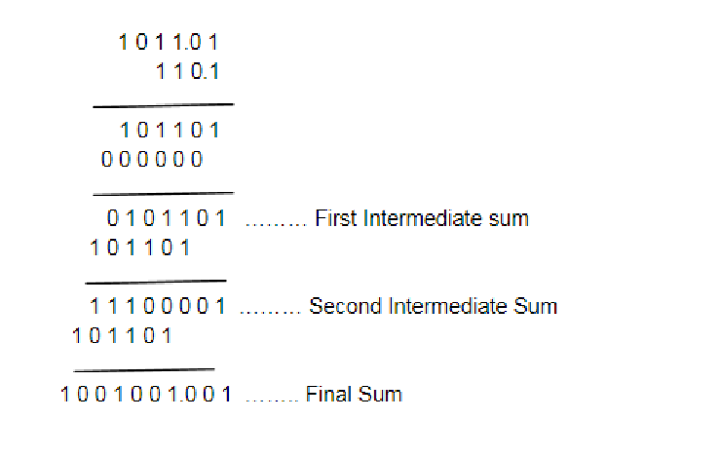
Binary Multiplication
4 Cases
0 X 0 = 0
0 X 1 = 0
1 X 0 = 0
1 X 1 = 1

Slide 39
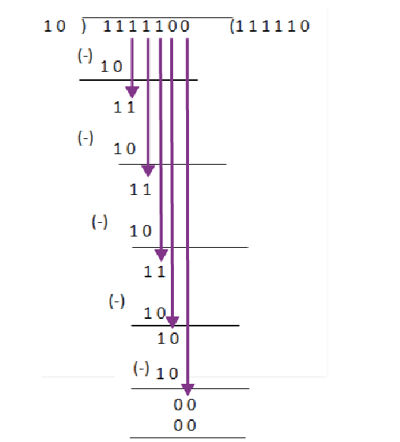
Binary Division

Slide 40
Binary Division
• Let us divide 128 by 8
• Let us divide 101010 by 110
• Now divide 26 by 5
• Do the same , but in binary : 11010 divided by 101

Slide 41
Binary Codes !!!
4

Slide 42
Binary Numbers and Binary Coding
Flexibility of Representation
• Within constraints below, can assign any binary combination (called a code word) to any data as long as data is uniquely encoded.
Information Types
• Non-numeric
• Greater flexibility since arithmetic operations not applied.
• Not tied to binary numbers
• Numeric
• Must represent range of data needed
• Very desirable to represent data such that simple, straightforward computation for common arithmetic operations permitted
• Tight relation to binary numbers

Slide 43
Binary Numbers and Binary Coding
Binary Code
Alphanumeric/Non-Numeric
Numeric
ASCII
EBCDIC
UNICODE
Binary Coded Decimal
7 bits
8 bits
UTF(Unicode Transformation)
8 bit
16 bit
32 bit
Weighted
Non-Weighted
8 4 -2 -1
6 3 1 -1
2 4 2 1
3 3 2 1
8 4 2 1
Gray Code
Excess 3-Code

Slide 44
Binary Coding ( Non-Numeric)
Given n binary digits (called bits), a binary code is a mapping from a set of represented elements to a subset of the 2^{n} binary numbers.
Example: A binary code for the seven colors of the rainbow
Color | Binary Number
Red | 000
Green | 001
Orange | 010
Yellow | 011
Blue | 101
Indigo | 110
Violate | 111

Slide 45
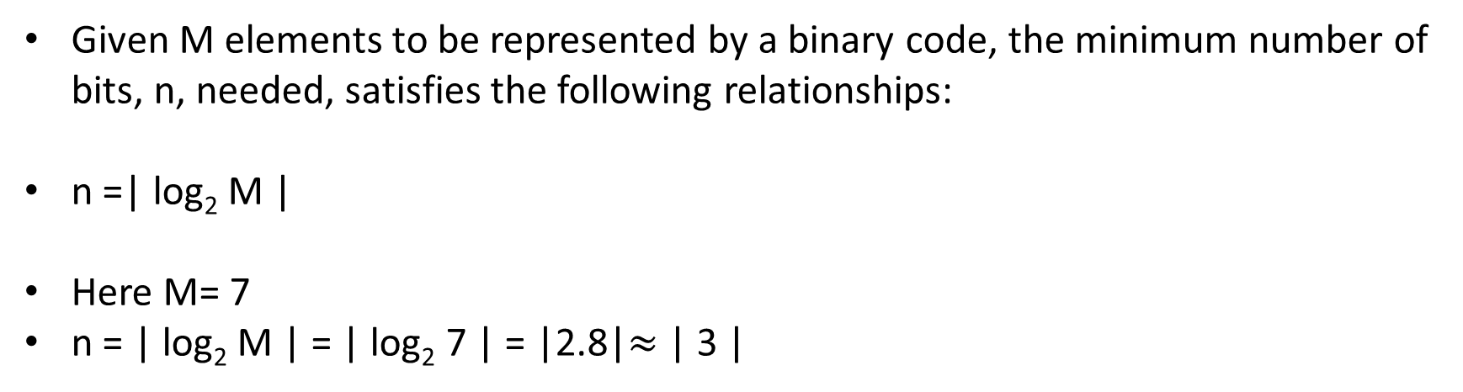
Binary Coding ( Non-Numeric)
Given M elements to be represented by a binary code, the minimum number of bits, n, needed, satisfies the following relationships:
n =| log₂ M |
Here M= 7
n = | log₂ M | = | log₂ 7 | = |2.8|$≈$ | 3 |
Color | Binary Number
Red | 000
Green | 001
Orange | 010
Yellow | 011
Blue | 101
Indigo | 110
Violate | 111

Slide 46
Binary Coding ( Non-Numeric)
Suppose you are using n number of digits, in radix r, there are maximum of r^{n} distinct elements that can be represented.
Examples :
You can represent 4 elements in radix r = 2 with n = 2 digits: (00, 01, 10, 11).
You can also represent 4 elements in radix r = 2 with n = 4 digits: (0001, 0010,0100, 1000).

Slide 47
Binary Coding ( Numeric)
There are over 8,000 ways that you can chose 10 elements from the 16 binary numbers of 4 bits. A few are useful:
Decimal | 8,4,2,1 | Excess 3 | 8,-4,-2,-1 | Gray
0 | 0000 | 0011 | 0000 | 0000
1 | 0001 | 0100 | 0111 | 0001
2 | 0010 | 0101 | 0110 | 0011
3 | 0011 | 0110 | 0101 | 0010
4 | 0100 | 0111 | 0100 | 0110
5 | 0101 | 1000 | 1011 | 0111
6 | 0110 | 1001 | 1010 | 0101
7 | 0111 | 1010 | 1001 | 0100
8 | 1000 | 1011 | 1000 | 1100
9 | 1001 | 1100 | 1111 | 1101

Slide 48
Binary Coded Decimal
• Each decimal digit is represented by a 4 bit binary number.
• 10 base system or radix 10 system
• It has binary representations for 10 different digits 0 to 9
• Weighted code with positional weights 8 4 2 1

Slide 49
Binary Coded Decimal
Warning: Conversion or Coding?
• Do NOT mix up conversion of a decimal number to a binary number with coding a decimal number with a BINARY CODE.
• 13₁₀ = 1101₂ (This is conversion)
• 13 ⇔ 0001|0011 (This is coding)

Slide 50
Binary Coded Decimal
Decimal | 8,4,2,1
0 | 0000
1 | 0001
2 | 0010
3 | 0011
4 | 0100
5 | 0101
6 | 0110
7 | 0111
8 | 1000
9 | 1001
Decimal | 8,4,2,1
10 | 1010
11 | 1011
12 | 1100
13 | 1101
14 | 1110
15 | 1111
Invalid
Valid

Slide 51
Binary Coded Decimal
Representation of a decimal number with Binary Coded Decimals
13 ⇔ 0001|0011
12 ⇔ 0001|0010
156 ⇔ 0001|0101|0110

Slide 52
Binary Coded Decimal
BCD number to decimal number
10100 ⇔ 1 4
1001001 ⇔4 9

Slide 53
Binary Coded Decimal
Tradeoffs between binary number and packed BCD (BCD coded number)
• BCD takes more storage
• Addition takes additional steps
• Decimal to BCD does not take much time

Slide 54
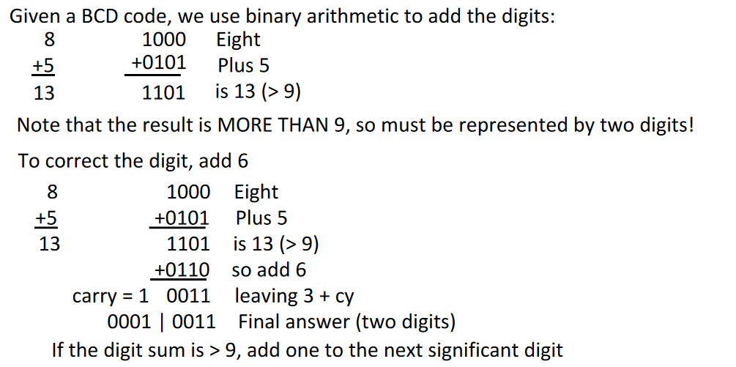
BCD Arithmetic

Slide 55
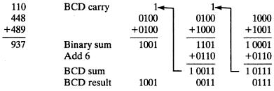
BCD Arithmetic
448 + 489 = (?)_{BCD}

Slide 56
BCD Arithmetic
Add 2905_{BCD} to 1897_{BCD} showing carries and digit corrections.
0001 1000 1001 0111
+ 0010 1001 0000 0101

Slide 57
BCD (Excess 3)
Decimal | 8,4,2,1 | Excess 3
0 | 0000 | 0011
1 | 0001 | 0100
2 | 0010 | 0101
3 | 0011 | 0110
4 | 0100 | 0111
5 | 0101 | 1000
6 | 0110 | 1001
7 | 0111 | 1010
8 | 1000 | 1011
9 | 1001 | 1100
• You know how to convert to binary
• You know how to add
• So, convert to binary and just add 0011 (3)

Slide 58
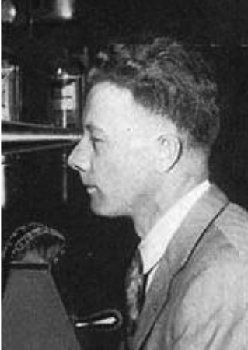
BCD Arithmetic (Gray Code)
Discovered by Frank Gray
Unweighted code
Two successive values differ in only 1 bit
Binary numbers are converted to gray code, to
reduce switching operations
Also known as Unit distance code

Slide 59
BCD (Gray Code)
Decimal | Binary | Gray
0 | 0000 | 0000
1 | 0001 | 0001
2 | 0010 | 0011
3 | 0011 | 0010
4 | 0100 | 0110
5 | 0101 | 0111
6 | 0110 | 0101
7 | 0111 | 0100
8 | 1000 | 1100
9 | 1001 | 1101
10 | 1010 | 1111

Slide 60
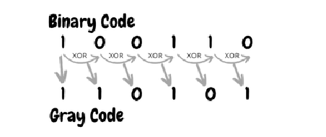
Binary to Gray Code
• Step1 : Record the MSB as it is
• Step 2 : Add the MSB to the next bit, record the sum and neglect the carry
• Step 3 : Repeat the process

Slide 61
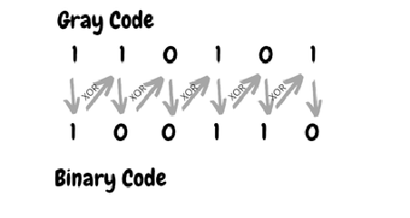
Gray Code to Binary
• Step1 : Record the MSB as it is
• Step 2 : Add MSB to the next bit of Gray code, record the sum and neglect the carry
• Step 3 : Repeat the process

Slide 62
Representation using binary numbers
Try yourself :
You want to represent all the countries in the world, using binary numbers. How many bits are required to do so?

Slide 63
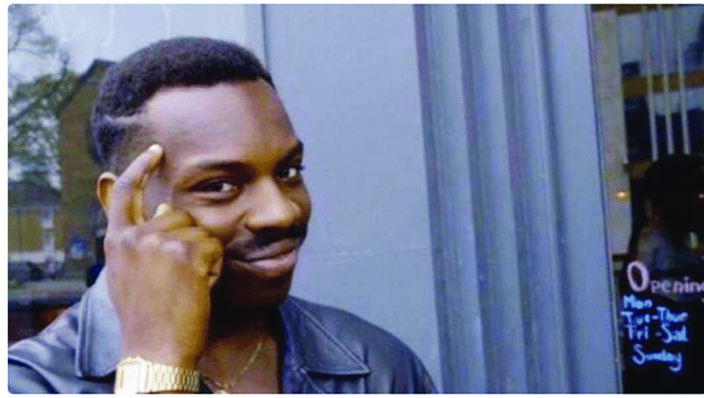
Representation using binary numbers
Try yourself :
You want to represent all the countries in the world, using binary numbers. How many bits are required to do so?
Total number of countries = 195
Ans: 8 bits

Slide 64

Representation using binary numbers
Suppose you have a register that can contain 4 bits, how many elements/ pieces of information can you represent?

Slide 65

Representation using binary numbers
Suppose you have a register that can contain 4 bits, how many elements/ pieces of information can you represent?
Ans: 2^{n} = 2⁴= 16

Slide 66


